Slide 1
Object Oriented JavaScript

Slide 2
Objective
Quick Intro to JavaScript
JavaScript Objects
JavaScript Function
Object Oriented JavaScript

Slide 3
JavaScript is not Java.
JavaScript was developed as a web-based scripting language which would exist exclusively on the World Wide Web. It was designed for short scripts which would be easily editable by web developers. The only relation JavaScript bears to its namesake is a similar syntax.

Slide 4
Wow factor of JavaScript
Real programming to your Web Pages.
It adds interactivity to static HTML
It can react to events
Helpful for Validation
Helpful to detect visitor’s browser to provide better and predictive services

Slide 5
Programing features
It has all the Operators like any other language.
Arithmetic Operators (+ - * / % ++ --)
Assignment Operators (= += -= *= /= %=)
Comparison operators (== != < > <= >=)
Logical operators (&&(logical and) ||(logical or) !(not))
Conditional operator( ?: )
It also has
Conditional Statements : (if , if …else, switch…case)
Iterative statements (while, do…while, for, for … in )

Slide 6
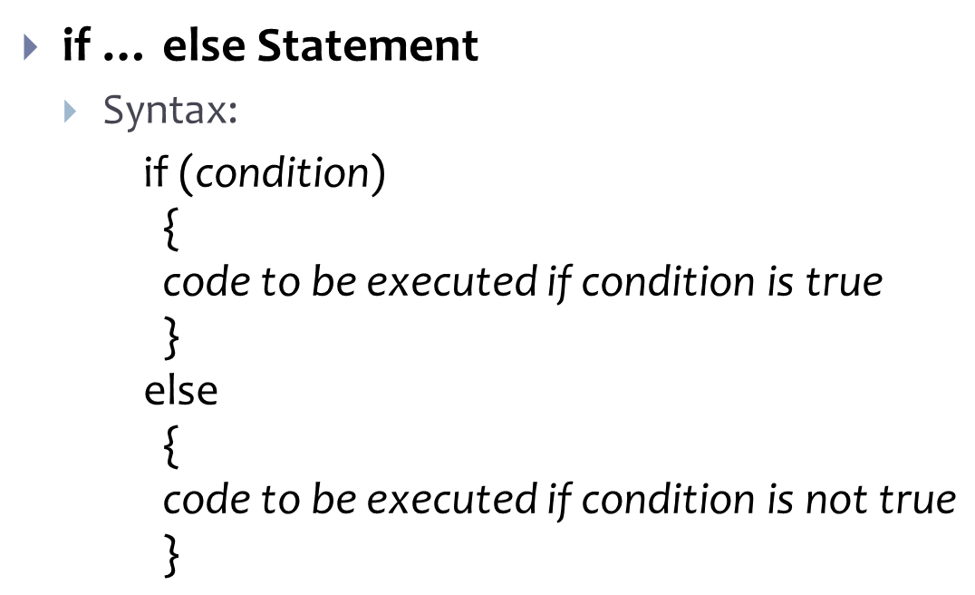
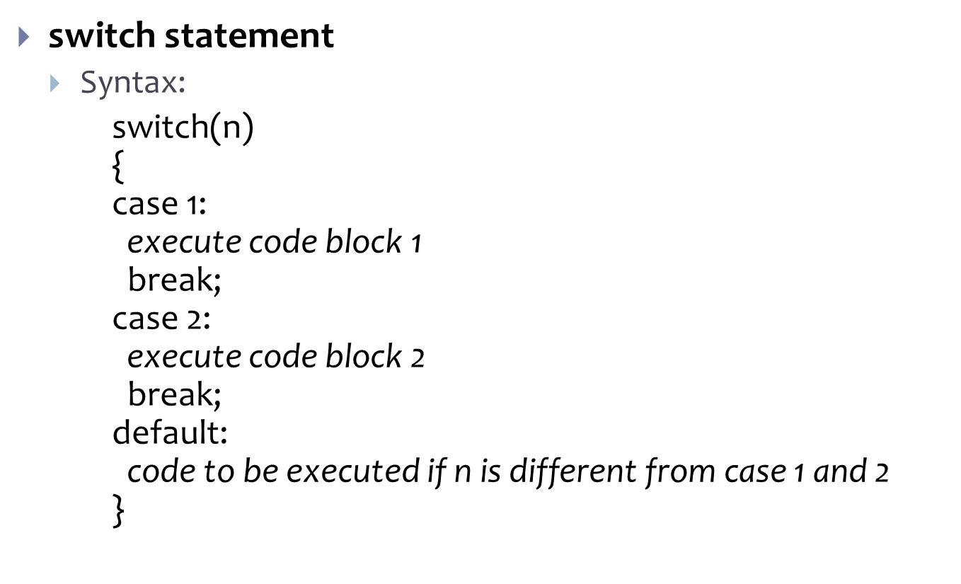
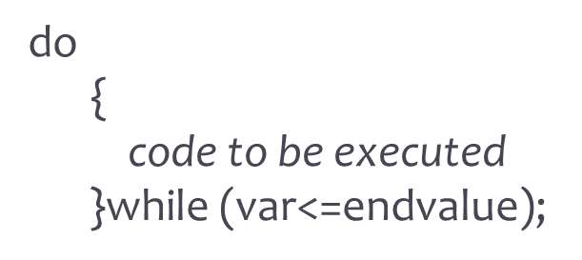
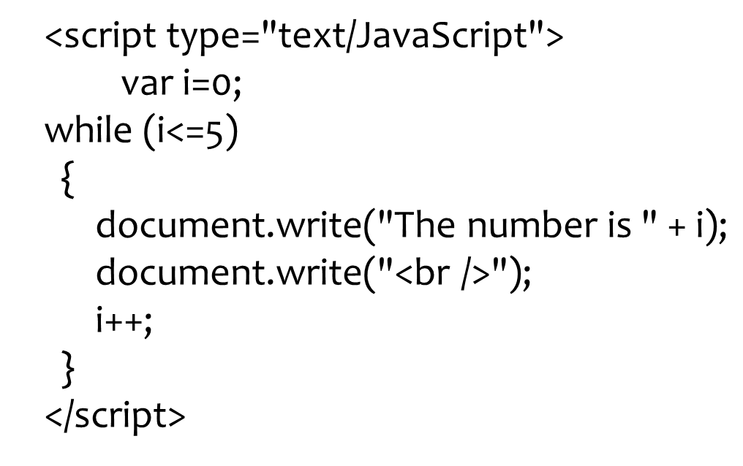
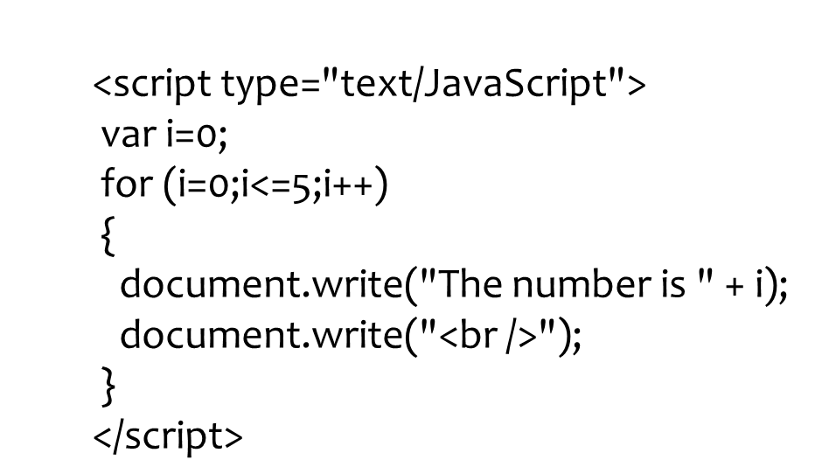
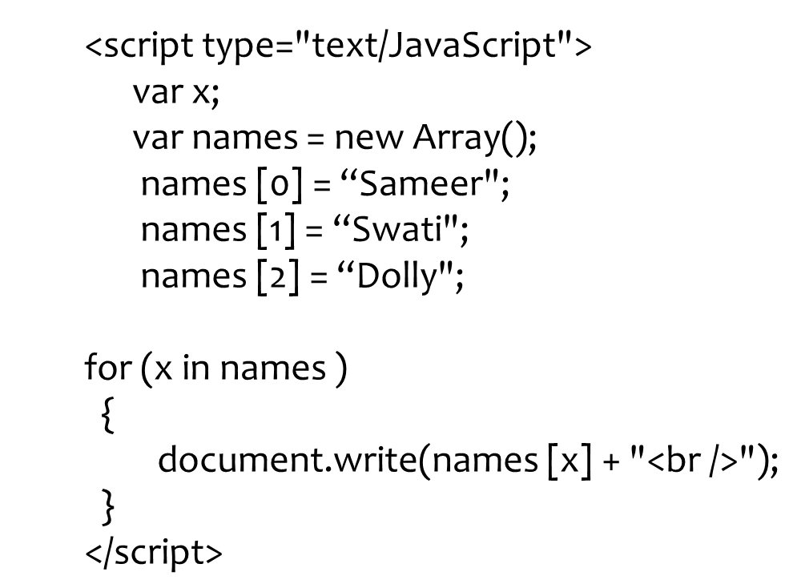
Code to understand Syntax

Slide 7
Built-In JavaScript objects
String
Date
Math
Boolean

Slide 8
String Object methods
var txt = new String(string);
or
var txt = string;
Implied properties
Length
Method | Description
charAt() | Returns the character at the specified index
concat() | Joins two or more strings, and returns a copy of the joined strings
toLowerCase() | Converts a string to lowercase letters
toUpperCase() | Converts a string to uppercase letters
split() | Splits a string into an array of substrings
Notes:
Example for split():
<script type="text/JavaScript"> var str="How are you doing today?"; document.write(str.split() + "<br />"); document.write(str.split(" ") + "<br />"); document.write(str.split("") + "<br />"); document.write(str.split(" ",3)); </script>
The output of the code above will be:
How are you doing today? How,are,you,doing,today? H,o,w, ,a,r,e, ,y,o,u, ,d,o,i,n,g, ,t,o,d,a,y,? How,are,you

Slide 9
Date Object
Date object is used to work with date. and time
Creating Date Object
new Date()
Example:
<script type="text/JavaScript">
var d = new Date();
document.write(d);
</script>
Method | Description
getDate() | Returns the day of the month (from 1-31)
getDay() | Returns the day of the week (from 0-6)
getFullYear() | Returns the year (four digits)
getHours() | Returns the hour (from 0-23)
setMinutes() | Set the minutes (from 0-59)

Slide 10
Example on Date Comparing
<script type="text/JavaScript">
var myDate = new Date();
//set date to 14-Jan-2010
myDate.setFullYear(2010, 0, 14);
var today = new Date();
if (myDate > today)
alert("Today is before 14th January 2010");
else
alert("Today is after 14th January 2010");
</script>
Notes:
Example: To display current Day Name
<script type="text/JavaScript">
var d=new Date();
var weekday=new Array(7);
weekday[0]="Sunday";
weekday[1]="Monday";
weekday[2]="Tuesday";
weekday[3]="Wednesday";
weekday[4]="Thursday";
weekday[5]="Friday";
weekday[6]="Saturday";
document.write("Today is " + weekday[d.getDay()]);
</script>

Slide 11
Array Object
Array object is used to store multiple values in a single variable
Creating/ Accessing array
// regular array (add an optional integer)
var names=new Array();
names[0]="Swati";
names[1]="Varsha";
names[2]="Dolly";
for (i=0;i<names.length;i++)
{
document.write(names[i] + "<br />");
}

Slide 12
Array Object Methods
Method | Description
concat() | Joins two or more arrays, and returns a copy of the joined arrays
join() | Joins all elements of an array into a string
pop() | Removes the last element of an array, and returns that element
push() | Adds new elements to the end of an array, and returns the new length
sort() | Sorts the elements of an array

Slide 13
Array Example
Join 3 arrays into single array
<script type="text/JavaScript">
var teamLeads = ["Janes", "Roschelle"];
var developers = ["Smith", "Jacob", "Raman"];
var testers = ["Lovleen", "Iram"];
var project_resource = teamLeads.concat(developers , testers );
document.write(project_resource );
</script>
Notes:
Example: (using join())
<script type="text/JavaScript">
var subjects = [“C", “C++", “Java", “.Net"];
document.write(subjects.join() + "<br />"); // default joining delimeter is ‘,’
document.write(subjects.join("+") + "<br />"); // uses ‘+’ as joining delimeter
document.write(subjects.join(" and ")); // uses string “and” as joining delimeter
</script>

Slide 14
More Example
Example: Numerically sorting of data
<script type="text/JavaScript">
function sortNumber(a, b) {
return a - b;
}
var n = [ "10", "5", "40", "25", "100", "1" ];
document.write(n.sort(sortNumber));
</script>

Slide 15
Math Object
The Math object allows you to perform mathematical tasks.
The Math object includes several mathematical constants and methods.
Using Math Object’s properties/methods
var pi_value=Math.PI; var sqrt_value=Math.sqrt(16);
Method | Description
abs(num) | Returns the absolute value of num
ceil(num) | Returns num, rounded upwards to the nearest integer
max(n1,n2,n3,n4) | Returns the number with the highest value
pow(x,y) | Returns the value of x to the power of y
sqrt(num) | Returns the square root of num

Slide 16
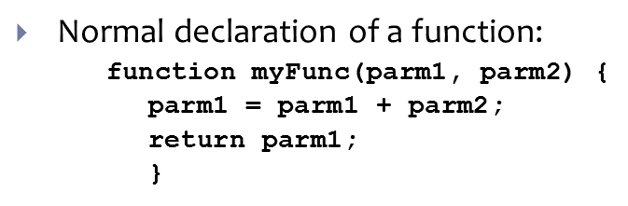
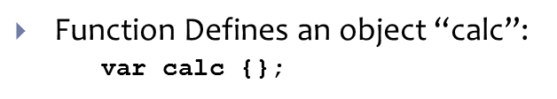
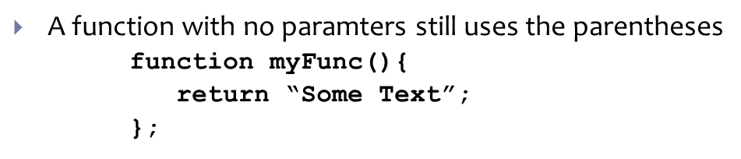
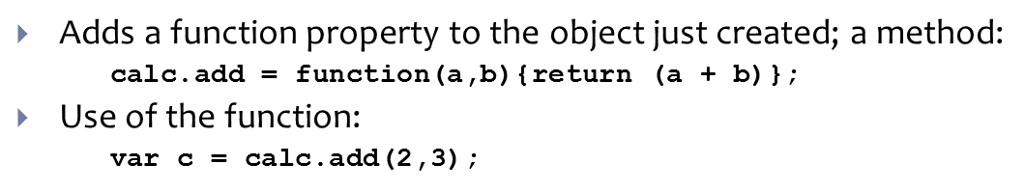
JavaScript Functions
Function treated as an object – a “first-class function”
Functions can be instantiated (created)
returned by other functions
Stored as an array element or object property or assigned to a variable
A JavaScript function stored as an object property is called a “method”
Functions can be nested

Slide 17
Object-oriented?
To qualify as object-oriented, programming languages must provide support for the following:
Data Abstraction
Encapsulation
Data protection
Inheritance

Slide 18
JavaScript is not an object-oriented language.
JavaScript does not support data abstraction in the form of Classes, neither is there support for data protection.
However, JavaScript is defined as an object-based language.

Slide 19
The JavaScript Object
Objects in JavaScript are merely lists of properties, functions, and other objects
There are three types of objects in JavaScript:
Native: strictly defined within the language. (Number, String, Image, etc.)
Host: Pre-defined by another source. Related to the script’s environment.
User-defined

Slide 20
Host Objects
Very often, JavaScript is used to interact with the DOM (Document Object Model), a hierarchy of all objects in a web document. Manipulating the DOM is one way to create dynamic web content. Every web browser can have its own version of the DOM, which can make scripting a bit problematic.

Slide 21
User-defined objects
Users can define their own objects by writing constructor function…
…and instantiating that function.
function Frog(name, color) {
this.name = name;
this.color = color;
}
var myFrog = new Frog(“Mothra II”, “#004400”)

Slide 22
User-defined objects
You may add, remove, or alter your object’s properties and methods at any time:
myFrog.size = "10px"
myFrog.kid = new Frog("Mothra III", "#337F00")
function sing(){
Document.write("It’s not easy being ") Document.write(this.color)
}
myFrog.croak = sing
delete myFrog.size

Slide 23
User-Defined Objects
While you can instantiate an object many times, the individual objects can be changed to anything at will. Objects instantiated by the same constructor won’t necessarily bear any resemblance to eachother.
There is no way to check two objects for similar ‘type’.

Slide 24
JavaScript: Object Based
Objects are at the very heart of JavaScript. It is a language created to alter things that have already been defined. Objects drive the language, and it is impossible to write useful JavaScript without them.

Slide 25
JavaScript Functions
All functions are executed as a method of some object
The ‘this’ keyword is a reference to the object which is executing the method
1) Global object is ‘this’ when function is defined in the page as a global function
2) DOM Event Handler – ‘this’ references the DOM element that hooked up the event
If you are in an HTML element nested in another element having an event and you click on the inner element, the click event will “bubble” up to the outer element that subscribed to the event and fire off. ‘this’ will refer to the outer element, not the element which triggered the event.
3) Constructor function – ‘this’ refers to the object being created
Properties of objects cannot be private in scope.

Slide 26
JavaScript Functions
Anonymous functions
You can define and use a function without giving it a name. Use the keyword ‘function’ instead of a name.
Example: you can assign a function to a variable and execute this variable like a function:
var myFunc = function(parm1, parm2){parm1 = parm1 + parm2; return parm1;}
Example: when you are assigning a function to a ‘click’ event, you can just define the function there instead of referencing one that was already declared
Closure
When nesting functions, variables declared in an outer function can be seen by the inner functions
(See function2.html)

Slide 27
JavaScript Functions
You can assign a function to a variable or an object property – a pointer – and use the pointer just like the function. So, you can have multiple ways to execute the same function. If the function changes, then all the pointers (variables) have the new functionality.
var c;
function myFunc(p1, p2){return p1 + p2};
var abc = myFunc;
c = abc(“Hello”, “World”);
(See function1.html)
Since a function is an object, you can create properties for it.

